Slide 1



DEC Mini Project
Movie Recommender System
Presented By :
PC-43 Dittee Salian
PC-44 Tejas Redkar
PC-49 Gayatrini Neogi
PC-50 Atharva Chaher

Slide 2



Introduction
About the project
Datasets
Preprocessing
Vectorizing & Similarity Cosine
Deployment
Conclusions
Contents

Slide 3


Introduction

Slide 4


A movie based recommender system is a software tool that suggests movies to users based on their personal preferences. It uses algorithms & machine learning to analyze data points, such as a user's previous movie choices & ratings, to generate personalized recommendations.
Introduction

Slide 5
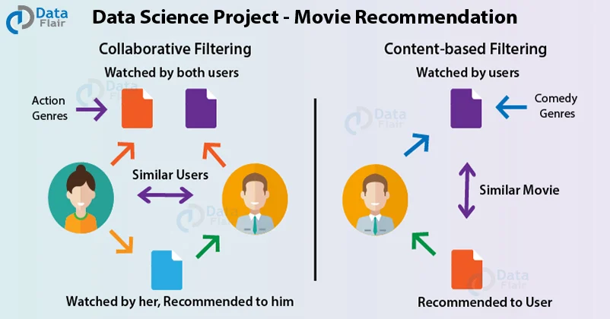
Introduction
There are various types of recommender systems which can be used to recommend content to users:
Collaborative filtering: Predicts a user's preference by aggregating ratings from users with similar tastes
Content-based filtering: Depends on data from one user for modeling
Cosine Similarity: Recommends movies based on factors such as genre, overview, cast, and ratings

Slide 6


About the project

Slide 7


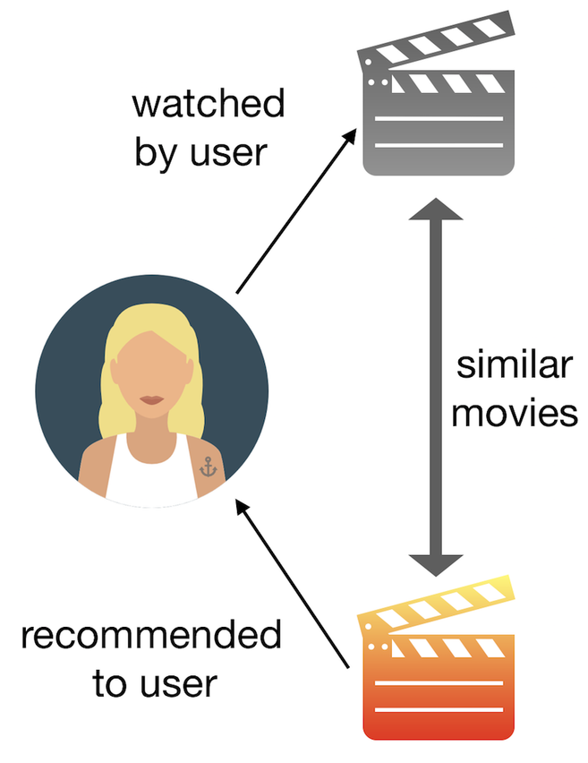

About the project
In this project we have downloaded a dataset from kaggle of approximately 5000 movies & their credits. This data is enough to train our recommender system to recommend movies to the specific user.

Slide 8



Datasets

Slide 9
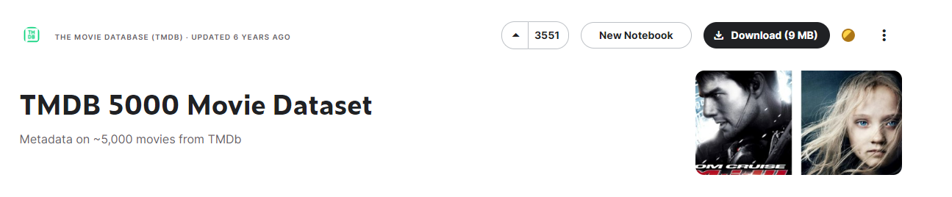

Datasets
The Dataset used in this recommender system is downloaded from Kaggle which is a dataset from TmDb which has 5000 movies & its credits

Slide 10
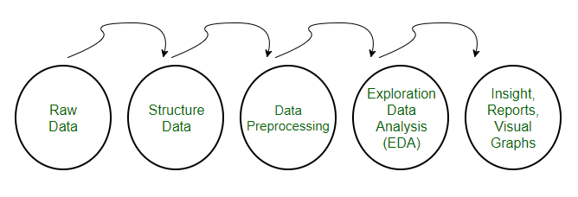
Pre-processing refers to the transformations applied to our data before feeding it to the algorithm. Data preprocessing is a technique that is used to convert the raw data into a clean data set. In other words, whenever the data is gathered from different sources it is collected in raw format which is not feasible for the analysis.
Preprocessing

Slide 11
Vectorizing & Similarity Cosine

Slide 12
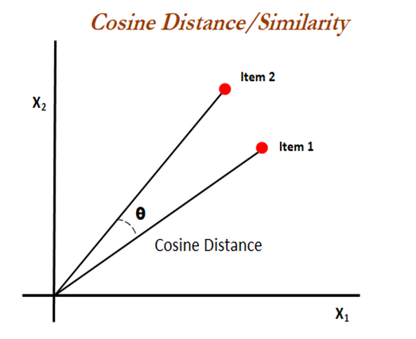
Vectorizing & Similarity Cosine
In machine learning, vectorization is a step in feature extraction. It involves converting text into numerical vectors to extract distinct features for the model to train on. These vectors are then used to build various machine learning models.
Some methods for performing vectorization on text data include: CountVectorizer, TF-IDF, Word2Vec.

Slide 13
Deployments

Slide 14
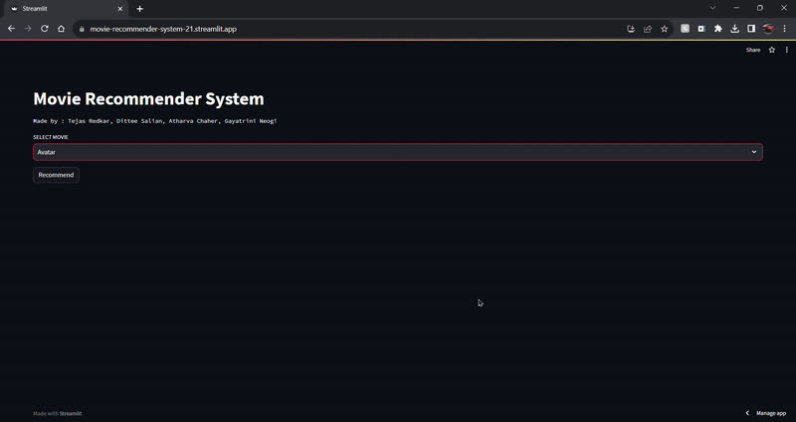
Here we are going to deploy the recommender system using streamlit frontend and hosting service
Deployments

Slide 15
Conclusion

Slide 16

Conclusion
In conclusion, the movie recommender system outlined in this report represents a significant advancement in the realm of personalized entertainment suggestions.
Through the integration of sophisticated algorithms, user preferences, and collaborative filtering techniques, the system successfully tailors movie recommendations to individual tastes, enhancing the overall viewing experience for users.
The system's ability to adapt and learn from user interactions ensures a continuous improvement in recommendation accuracy over time. This dynamic nature not only increases user satisfaction but also contributes to user retention and engagement.
Moreover, the incorporation of diverse features such as genre preferences, historical viewing patterns, and real-time user feedback enhances the system's versatility, making it adaptable to a wide range of user profiles. The user interface, designed for simplicity and user-friendliness, further contributes to the overall positive user experience.

Slide 17

Thank
you

